Slide 1
Patient Centric Clinical Trials: An Overview of the CCTG Strategic and Scientific Agenda
2024 NICTC
Janet E Dancey

Slide 2
Outline
Outline
What are patient centric trials
Why we aspire to do them
What are the key approaches to design and conduct patient centric trials

Slide 3
Question: Who are trials for?
Investigator
Regulator
Ethics Board
Sponsor
Institution
Trial Staff
Patient & Carer
Regulators
Ethics
Sponsor
Clinician & Team
Institution
Patient

Slide 4
What Does It Mean for Clinical Trials to be Patient-centric?
Trials are designed specifically around patient needs, include patient reported outcome measures, and/or are co-designed with patients.
Therefore, consider and/or include patients in
Assessing priority of the trial question
Trial design and endpoints
Execution,
Communication of results
AKA “patient centered”, “patient focused”, “patient friendly”
The aim is to ensure that trials are relevant and convenient for patients and their carers.
And, patients are asked instead of guessing what they need.

Slide 5
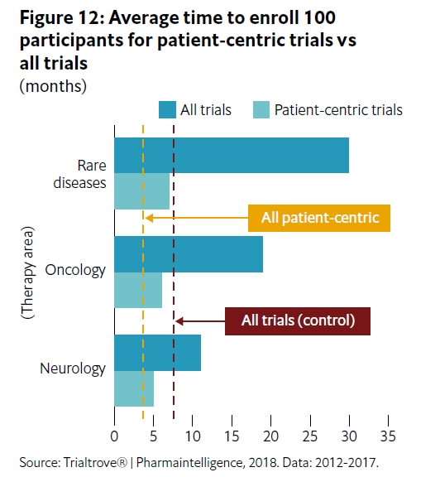
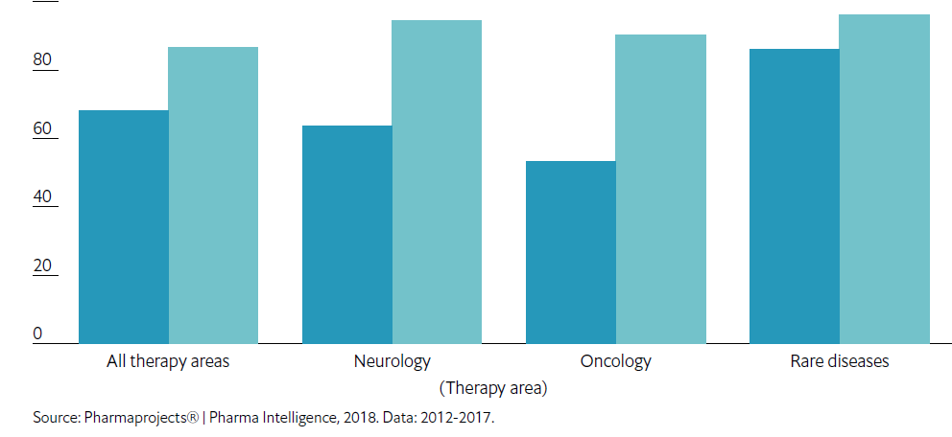
Benefits of Patient-Centric Trials
Average time to enroll 100 patients
Patient centric versus all trials
Better recruitment and retention
Patient-centric trials took just four months on average to recruit 100 participants—significantly less than the all-trials average of seven months
Better designs/better impact
Drugs developed with patient-centric trials had an 87% chance of being launched versus 68% for drugs that didn’t go through patient-centric trials only had a 68% chance of being launched.
Expected by funders, sponsors, patients groups.
Phase II/III likelihood of launch for patient-centric versus all trials
Notes:
Likelihood of launch was 13 percentage points
higher for adaptive trials than for all trials
(control), while for patient-centric trials it was
19 points higher, for precision medicine trials it
was 10 points higher

Slide 6
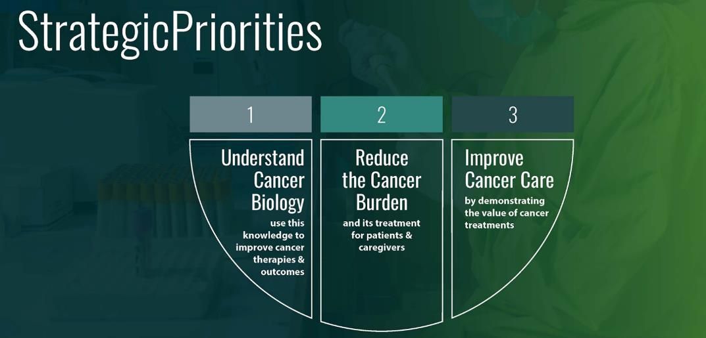
The CCTG Strategic Plan Explicitly Acknowledges the Centrality of Patients to its Research
“CCTG trials”
• address questions important to researchers, clinicians and patients;
• evaluate interventions that are innovative; have the potential to change clinical practice;
• reflect an international caliber of science; and,
• include patients as partners.”
Notes:
Welcome everyone, and thank you for attending this important workshop.

Slide 7
CCTG Patient Representative Committee has Contributed to CCTG Research since 1990s
Patient Representative Committee
Group
Established
1980 | 1982 | 1988 | 1990 | 1994 | 1994 | 1996 | 1998 | 2000 | 2002 | 2004 | 2006 | 2008 | 2010 | 2012 | 2014 | 2016 | 2018 | 2020 | 2220 | 2024
IND Program
Pre-2012 – Meeting Centric
INFORM
Attendance at annual Spring Meeting
2013-2014 – Committee-Centric
INVOLVE
Full engagement in Committees:
2015-2020 Product-Centric
COLLABORATE
Full engagement in trial lifecycle:
Quarterly conference calls
Expectations defined
Recruitment
Orientation
Tools
Training
Ideation
Prioritization
Protocol & consent development
Trial conduct
Dissemination of results
Notes:
So why are we a leading Patient Engagement Model – what sets us apart?
Patient Engagement in CCTG was implemented in a phased approach.
Patients were first invited to attend CCTG’s meetings in the early 90’s and were primarily meeting attendees, an IAP2 “Inform” level
In 2013 expectations were redefined, recruitment, orientation, training and tools were developed to enable engagement in meetings, better enabling investigators to call upon their patient reps to provide input into discussions, an “Involve” level of engagement.
In 2015-16 we upped engagement with full participation in the trial lifecycle, from ideation through to trial closure. – this brought us to an IAP2 “Collaborate” level of engagement.
Still today, most organizations are at an “Inform” or “Involve” level of engagement.

Slide 8
Patient Representatives in CCTG provide their Views Across Leadership Committees
Research Oversight
Clinical Trials Committee
Scientific Peer Review
Data Safety Monitoring Committee
Safety and Quality
Scientific Priorities Trial Portfolio
Endpoint Committees
Scientific Committees
Support Committees

Slide 9
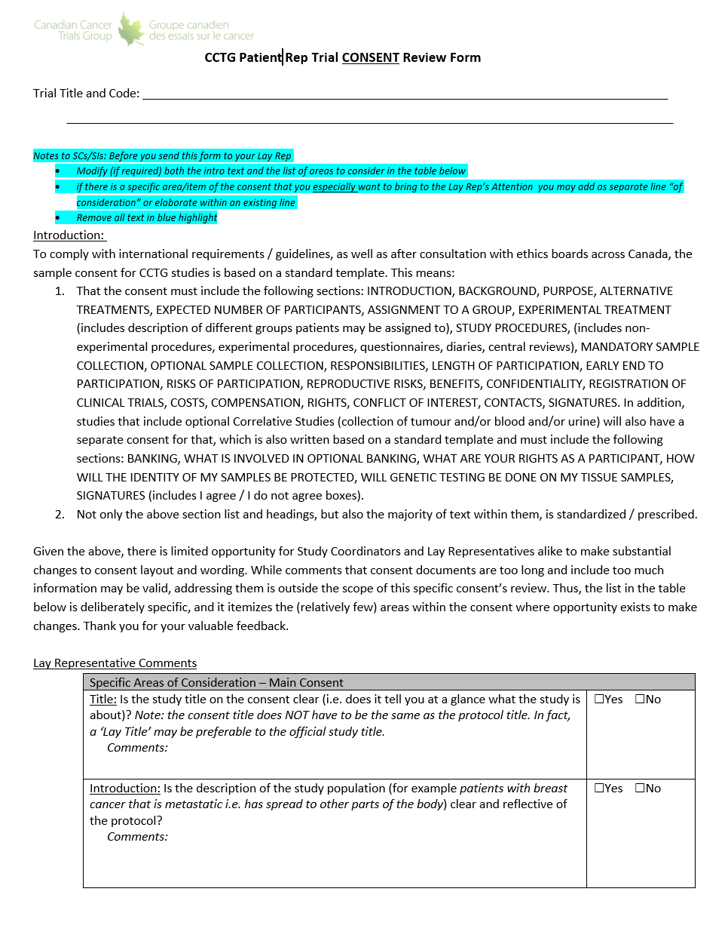
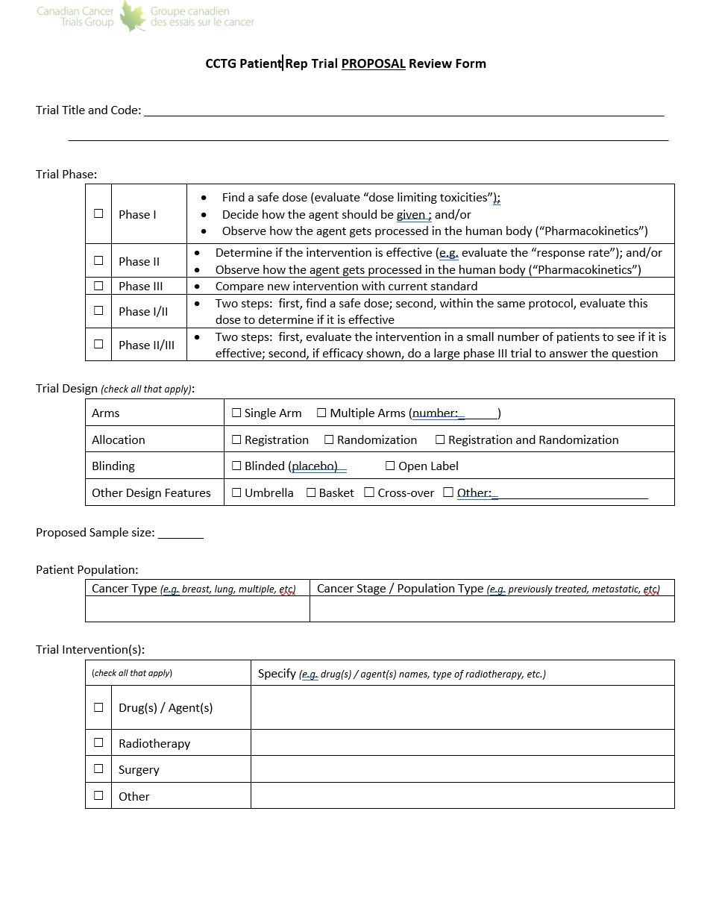
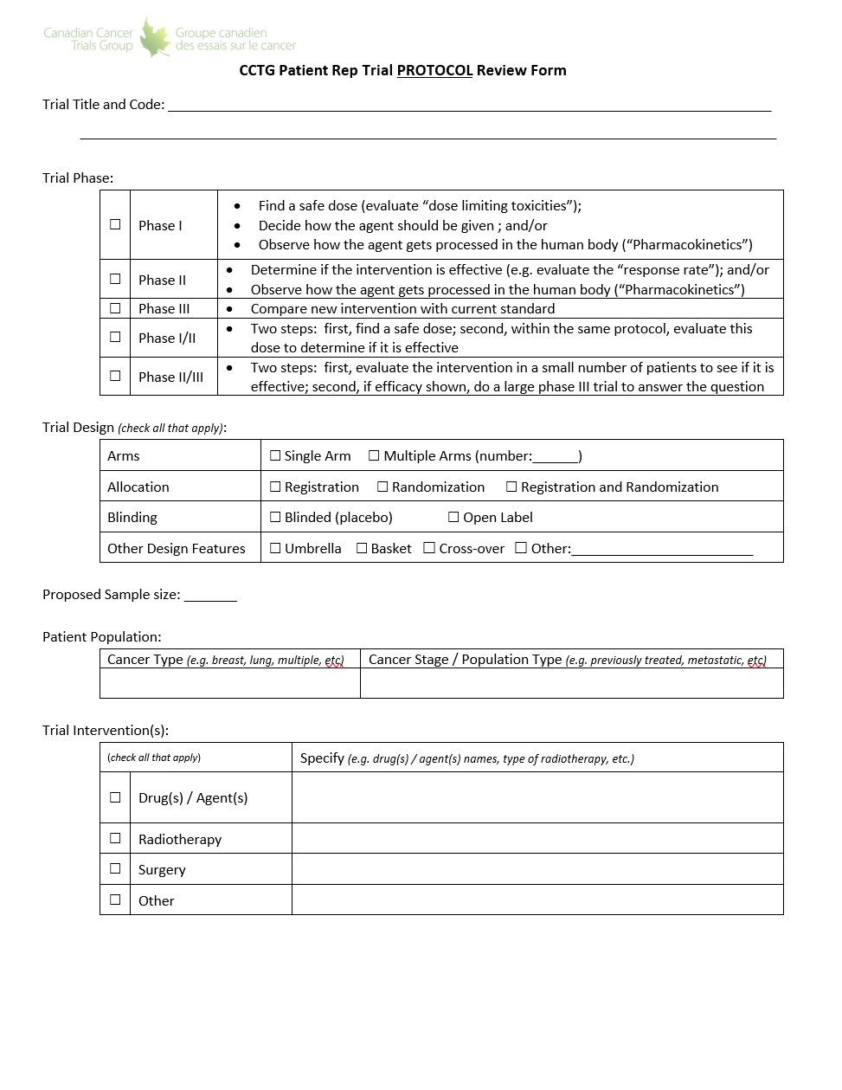
Patient Engagement in the CCTG Clinical Trial Lifecycle is Defined and Patient Representatives are Trained and Supported
Ideation
Defined the touchpoints in the clinical trial lifecycle that would benefit from patient input.
Developed and implemented the processes, tools and training material that enabled Patient Reps to contribute easily yet formally at each defined touchpoint.
Proposal Development
Proposal Review / Approval
Develop Protocol & Consent
Operations Centre Activation
Assess research question, design, execution, patient materials, recruitment plans, patient information
Cancer Centres Activation
Accrual & Data Collection
Closure to Accrual
Follow Up/Data Collection
Endpoint(s) Met
Legend:
Current
Patient Engagement
Planned
Patient Engagement
Needham J, et al. Integrating Patient-Centred Research in the Canadian Cancer Trials Group. Current Oncology. 2021; 28(1):630-639
Analysis & Reporting
Permanent Closure
Notes:
So why does this set us apart?
Because through the developed and implemented the processes, tools and training material reps formally contribute formally at each indicated point in our clinical trial lifecycle.
This happens with every CCTG trial as it passes through these phases.

Slide 10
Patient Centric Trial Questions Cover Range of Settings, Interventions, Modalities
Prevention
MAP3 - A Phase III Randomized Study of Exemestane Versus Placebo in Postmenopausal Women at Increased Risk of Developing Breast Cancer
OV25 - A Randomized Phase II Double-Blind Placebo-Controlled Trial of Acetylsalicylic Acid (ASA) in Prevention of Ovarian Cancer in Women with BRCA 1/2 Mutations (STICs and STONEs)
Early Detection
PAC4 (ECOG-ACRIN EA2185) Comparing the Clinical Impact of Pancreatic Cyst Surveillance Programs
MAC22 - Tomosynthesis Mammographic Imaging Screening Trial (TMIST)
Treatment De-escalation
PR7 Intermittent versus Continuous Androgen Suppression
CX5 Simple hysterectomy versus standard radical hysterectomy for low-risk, early-stage cervical cancer
Symptom management/supportive care
SC24 - A Randomized Phase II/III Study Comparing Stereotactic Body Radiotherapy(SBRT) versus Conventional Palliative Radiotherapy (CRT) for Patients with Spinal Metastases
SC26 - Emotion and Symptom-focused Engagement (EASE): A Multi-Site Randomized Controlled Trial of an Intervention for Individuals with Acute Leukemia
Vulnerable/often excluded patient groups
CE6 Temozolomide with radiation in the elderly

Slide 11
Patient Centric Trial Designs, Conduct and Endpoints
Trial information is available, findable understandable, and provided
Multimedia, multilanguage, community awareness
Simplified informed consent & process
Protocol interventions balance burden to patient due to time/distance/costs with oversight to ensure safety, quality and scientific objectives are met.
Understanding what is required of them (meds, visits, tests, digital technologies)
Endpoints are relevant and meaningful
Patients are aware of significant trial changes and outcomes
Patient recruitment
Efficacy
Informed consent
Eligibility
Patient & Carer
Safety & Toxicity
Treatment
Assessment Visits

Slide 12
Patient Engagement and Trial Information
“I see recruitment as being a by-product of good patient engagement… Patients should become part of the process, and that translates into them signing up for the project and being included. It can’t just be tokenism.”
Deborah Collyar, President, Patient Advocates in Research (PAIR)
Patients are increasingly driven to seek out information about potential new treatments, and able to do so. They are also—either through the advocacy of patient organizations, or simply by spreading the word loudly across the internet and the media—able to make their voices heard.
Patients will get information and advice from many sources. Accurate, understandable, trusted, and compliant information and sources are important for them and for trial investigators
Barron D. Making the patient-centric trial a reality [Internet]. London: Eyeforpharma. Available from: https://social.eyeforpharma.com/clinical/making-patient-centric-trial-reality.
Vicari S, Cappai F. “Health activism and the logic of connective action. A case study of rare disease patient organizations”. Information, Communication & Society. 2016 Nov 1; 19(11): 1653–1671.
Darmawan I, Bakker C, Brockman TA, Patten CA, Eder M. The Role of Social Media in Enhancing Clinical Trial Recruitment: Scoping Review. J Med Internet Res 2020;22(10):e22810; doi: 10.2196/22810

Slide 13
Magnitude of Barriers for Patient Participation
Unger J, et al. J Natl Cancer Inst, 111, (3) 245–255, https://doi.org/10.1093/jnci/djy221
Notes:
Figure 4. Magnitude of barriers for each domain for academic sites, community sites, and all sites combined. The P value was derived from a z score in a random effects model. A two-sided test was used.
Unless provided in the caption above, the following copyright applies to the content of this slide: © The Author(s) 2019. Published by Oxford University Press.This is an Open Access article distributed under the terms of the Creative Commons Attribution Non-Commercial License (http://creativecommons.org/licenses/by-nc/4.0/), which permits non-commercial re-use, distribution, and reproduction in any medium, provided the original work is properly cited. For commercial re-use, please contact journals.permissions@oup.com

Slide 14
Equity gaps in clinical trials have multiple causes, in Canada, one is Geography
Cancer Type
Age
Clinical Trial type
Number of cancer trials available for every 10,000 individuals (according to 2021 census) in each Canadian Jurisdiction
6.795
Studies per 10,000 individuals
Equity-denied populations
0.0
Geography
Powered by Bing ©GeoNames, Microsoft, TomTom
Academic vs Industry-led
For example, there are ‘cancer clinical trial deserts’ across the country where access is extremely limited or non-existent for patients.
Abdel-Rahman O. Geographic Disparities in Access to Cancer Clinical Trials in Canada. American Journal of Clinical Oncology [Internet]. 2023 Nov 1 [cited 2024 May];46(11):512.

Slide 15
Addressing Geography Gaps with Decentralized Trials
E-Tools/Digital Technologies to engage patients directly with sponsor or through participating trial site
Shared patient management between trial investigators/sites
Technical, operations, cultural, system changes are required for broad adoption
Shared patient management*
E-Tools
*Also called Patient sharing, hub-spoke cluster, local network
Notes:
Clinical trials offer the best care for patients with cancer but that less than 5% of patients enroll in trials worldwide.¹
DCT whether using digital tools to support trial conduct directly between sponsor and patient or by enabling remote or shared patient management among a cluster of sites may create additional opportunities for interested patients to participate in trials.
DCTs may expand recruitment, facilitate consent, and reduce costs and improve quality of data collection using digital tools
Reduce geographic barriers, costs and time toxicity for patients through shared patient trial management within a local network of trial site and satellite health service providers

Slide 16
Rationale for Adoption DCTs Speed, costs, quality, diversity/representation
Key drivers of increased adoption
Key objectives for adoption
E-Tools
E-Tools
Daly B, et al. JAMA Netw Open. 2024;7(4):e246228. doi:10.1001/jamanetworkopen.2024.6228
Notes:
The Bloomberg New Economy International Cancer Coalition conducted a survey study of 8 biopharmaceutical companies representing 33% of the oncology marketplace,
Respondents noted key drivers were competition for patients, improving technologies, expectations of stakeholders
Key objectives of industry DCTs were to broaden access, speed and diversity

Slide 17
Digital Tools for Trials
Inan, O. T. et al. Digitizing clinical trials. NPJ Digit. Med. 3, 101 (2020).

Slide 18
Traditional and Digital Trials
Mayo Clinic Proceedings 2023 981568-1578DOI: (10.1016/j.mayocp.2022.10.001)

Slide 19
Digital Technologies
Wearables, tele-health visits, online patient diaries, eConsent, video dosing confirmation, patient apps etc are now available and may reduce disparity of access based on where patients live BUT… These may create their own burdens if not simply to use, readily available and robust
Key features:
Intuitive: When a patient looks at whatever they’ve been asked to use, whether it’s an app on a mobile device, it has to be clear right away what they need to do. They shouldn’t have to take a training course.
Elegant: The device or app should provide only what the patient needs, and no more. Simpile options and menu items, that patients need to do.
Accessible: If possible, use “bring your own device” (BYOD) technologies. Choose apps and devices that work with a familiar platform, that patients already know how to use so they will use it
Robust: Pick the tools that are reliable and that are readily available when patients need them.
Limited: All of the necessary functions and features must be available in one app, one user interface and one workflow
Validated: it does what it is intended to do for patient and for the trial, and is secure.
Compliant: with regulations/legislation
Resourced: (people and infrastructure) available for management of devices and data generated.
Valachis A & Lindman H. Lessons learned from an unsuccessful decentralized clinical trial in Oncology. NPJ Digital Medicine 7(1) (2024) https://doi.org/10.1038/s41746-024-01214-5;
Chhatre, S. et al. Patient-centered recruitment and retention for a randomized controlled study. Trials 19, 205 (2018).
Rogers, A. et al. A systematic review of methods used to conduct decentralised clinical trials. Br. J. Clin. Pharmacol. 88, 2843–2862 (2022).

Slide 20
Hybrid Trials
Traditional or Hub/Spoke
Mayo Clinic Proceedings 2023 981568-1578DOI: (10.1016/j.mayocp.2022.10.001)

Slide 21
Preconditions & Recommendations for successful Cluster Trial Sites Sharing Patients
Clear regulatory guidance,
Existing healthcare infrastructure and organization,
The professional, institutional, patient support for implementation
Clinical trial resource and expertise for implementation
Right Trial (to start)
Complexity of protocol interventions, data management, oversight, delegated study activities
Recruitment period
Right Satellites
Recruiting, potential, collaborative, existing relationship
Expedite Agreements Process
ONE institutional Master Research Agreement with each prospective satellite, Statement of Work for each new trial
Clear, frequent, ongoing communication
Janet Dancey. Evaluating DCTs
Notes:
DCT trials will continue to expand in numbers
A local network/hub-spoke of cluster of sites is feasible to set up

Slide 22
CCTG DCT Trials to date
CCTG trial scenarios for patient sharing
Are sites all member centres?
Which trial protocol procedures will be done at satellite
Oversight of the satellite site
CTA/Investigational drug
14 trials with DCT elements launched
Standard of care delivered at satellite sites (10 trials)
Patient directed recruitment, E-consent (1 Observational study, 1 trial)
E-Patient reported outcomes (multiple trials)
Patient linkage to population health data for vital status (1)

Slide 23
Challenges to Patient-Sharing DCT Activities
Key priority is to ensure patient safety & protocol compliance
Sustained capacity to support trial conduct within cluster
Institution concerns
Privacy and sharing of data/information
SOC (or non-SOC) activities can be performed at satellite as part of research
Capacity and priority to execute agreements
Ethics board oversight of activities at satellites
Regulator
Ethics Board
Sponsor
Clinician & Team
Institution
Patient

Slide 24
CRAFT Development & Knowledge Mobilization
CRAFT Toolkit
Resources for Primary Sites to assess, set up & manage satellite involvement
Satellite Feasibility Assessment
Agreement Templates:
Clinical Research Agreement (Institutional)
Statement of Work (SOW)
Satellite Supervision Plan
Delegation Log
Site SOPs (where required)
Janet Dancey. Evaluating DCTs

Slide 25
Endpoints that Matter
Clinical Benefit Endpoints
Overall Survival (OS) – The time between treatment and death. This measure includes death from any cause, including both the disease being treated and unrelated conditions. This means that OS, unlike some other endpoints, measures both the impact of a treatment after relapse and the survival impact of treatment side effects.
Quality of Life (QoL) – A drug’s impact on pain or other symptoms related to a condition. Because many cancer treatments have negative side effects, drugs with the potential to improve Quality of Life can offer patients substantial benefits over existing treatments. Also Patient Reported Outcome, or PRO, meaning that it relies on patients’ accounts of a drug’s impact.
Other Endpoints Used
Disease Free Survival (DFS) – The length of time between treatment and relapse. This endpoint is generally used with treatments that leave patients without any detectable signs of disease, such as surgery.
Progression Free Survival (PFS) – The length of time between treatment and measurable worsening of the disease. Generally used to study advanced diseases that are unlikely to be removed entirely.
Response Rate (RR) – The percentage of patients whose cancer shrinks or disappears after treatment. Frequently used in single-arm trials, as it does not require direct comparison with a control.
https://friendsofcancerresearch.org/glossary-term/clinical-trial-endpoints/

Slide 26
Guiding Principles of Common Sense Oncology
Access to quality cancer care is a basic human right—no patient should be denied access to effective therapy or forced into financial catastrophe to access meaningful cancer care.
Patient and societal needs should drive cancer research and delivery of care.
Patient and public involvement is essential when making policy decisions.
Patients should expect that recommended cancer treatments meaningfully improve their survival or quality of life.
Shared decision making between patients and oncologists should be based on patient values and grounded in evidence-based medicine and critical appraisal.
Cancer treatments should be fairly priced for the context in which they are used.
Equity in access to high-quality care should be prioritized as much as innovation and new treatments.
Comprehensive and holistic cancer care includes survivorship care, psychosocial oncology, and timely integration of palliative care.
Booth CM, Sengar M, Goodman A, et al: Common Sense Oncology: Outcomes that matter. Lancet Oncol 24:833-835, 2023

Slide 27
SHAPE TRIAL
An international randomized phase III trial comparing radical hysterectomy vs simple hysterectomy in patients with early cervical cancer
RANDOMIZE 1:1
Arm 1
(Control)
Radical Hysterectomy*
Low-risk
cervical cancer:
< 2 cm
Pelvic recurrence rate at 3 years
Arm 2 (Experimental)
Simple Hysterectomy*
27

Slide 28
Quality of Life and Sexual Health
Scale | Effect Estimate* | P-value
EORTC QLQ-C30 pain scale | -4.53 | p=0.02
EORTC QLQ-CX24 Symptom experiences | -2.12 | p=0.02
Body Image | -5.22 | p=0.02
Sexual Worry | -6.67 | p=0.04
Sexual Activities | -7.59 | p=0.003
Sexual Enjoyment | -7.67 | p=0.049
FSFI Desire | 0.37 | p=0.002
FSFI Arousal | 0.38 | p=0.003
FSFI Lubrication | 0.36 | p=0.008
FSFI Total Score | 1.82 | p=0.006
FSDS Total Score | -2.47 | p=0.02
Significant differences were seen between the 2 groups over time and all were in favor of the simple hysterectomy group

Slide 29
Endpoints that Matter to Patients
PROs as primary endpoints
Rigor of selection, design, execution of PRO/endpoint, data collection, and interpretation.
CONSORT-PRO extension reporting recommendations for reporting
PROs as secondary endpoints provide information of additional benefits and risks beyond the primary trial outcome and toxicity data.
PROs further informed important additional domains such as satisfaction with treatment and utility estimates that had impact on additional evaluation of the study interventions.
Brundage M, et al. Listening to the Patient Voice Adds Value to Cancer Clinical TrialsJNCI J Natl Cancer Inst (2022) 114(10): djac128

Slide 30
Regulator Expectations
US Food and Drug Administration (FDA): systematic incorporation of the patient voice into all aspects of drug development and evaluation.
2009 Patient-reported Outcome (PRO) guidance for industry
2012 Patient-Focused Drug Development (PFDD) initiative to incorporate the patient experience into medical product development.
2021-2022 Four-part guidance series
https://www.fda.gov/drugs/development-approval-process-drugs/fda-patient-focused-drug-development-guidance-series-enhancing-incorporation-patients-voice-medical Guidance 1: Collecting Comprehensive and Representative Input Guidance 2: Methods to Identify What is Important to Patients Guidance 3: Selecting, Developing or Modifying Fit-for-Purpose Clinical Outcomes Assessments Guidance 4: Incorporating Clinical Outcome Assessments into Endpoints for Regulatory Decision Making
Collectively, the goal of these initiatives is to develop interventions that induce a treatment benefit that is considered meaningful to patients.
Notes:
Methods to collect patient experience data that are accurate and representative of the intended patient population (Guidance 1)
Approaches to identifying what is most important to patients with respect to their experience as it relates to burden of disease/condition and burden of treatment (Guidance 2)
Approaches to selecting, modifying, developing, and validating clinical outcome assessments (COAs) to measure outcomes of importance to patients in clinical trials (Guidance 3)
Methods, standards, and technologies to collect and analyze COA data for regulatory decision-making, including selecting the COA-based endpoint and determining clinically meaningful change in that endpoint (Guidance 4)

Slide 31
Identifying Meaningful Aspects of Health in Digital Measure Development: Key Examples
Therapeutic Area | Digital Measure | Research Team | Methods for Identifying MAH | Regulatory Success
Atopic Dermatitis | Nocturnal scratch | Digital Medicine society (DiMe) multi-stakeholder collaborative | - MAH were established through concept-elicitation interviews with 49 patients comprising adults, children and caregivers, which informed a conceptual model for scratching as a concept of interest³⁷. - In a survey, experience and burden of nocturnal scratch was further explored, including their preferences on treatment options and their willingness to use DHTs to measure nocturnal scratch³⁷. | LOI accepted by FDA (in a separate submission for scratch sensor in atopic dermatitis)⁵⁸
Idiopathic Pulmonary Fibrosis (IPF) | Moderate-to-vigorous physical activity (MVPA) | Bellerophon Pharmaceutical | - Preliminary evidence of MAH were generated with the help of the Voice of Patient report from an FDA-led PFDD meeting including 60 IPF patients¹⁶. - Patients expressed that IPF limits their ability to perform activities of daily living, particularly those which require high levels of exertion like walking, climbing stairs, and exercise⁵⁹. | Endpoint accepted by FDA in a phase 3 IPF clinical trial
Duchenne Muscular Dystrophy (DMD) | Stride velocity 95th centile (SV95C) | ActiMyo® research collaborative | - MAH were established through qualitative investigation that included discussions with key clinical experts and stakeholders from private and public organizations and a survey of patients and caregivers that gathered in-depth feedback on the meaningfulness of ambulation in DMD and acceptability of wearable devices in this context⁴⁰. | LOI accepted by FDA³⁹; and endpoint qualified by EMA in DMD clinical trials⁴⁰
Aryal, S., Blankenship, J.M., Bachman, S.L. et al. Patient-centricity in digital measure development: co-evolution of best practice and regulatory guidance. npj Digit. Med. 7, 128 (2024). https://doi.org/10.1038/s41746-024-01110-y

Slide 32
Providing Trial Information and Trial Results
Trial participants should receive information of importance to them that may impact their ongoing consent.
Dear Doctor Letters
Patient Information Letters for safety/results
Reconsent using reviewed/updated consent
Traditional scientific presentations/publications
Open access/publicly available
Trial registry updates
Lay/public focused descriptions in lay language (also called layperson summaries, plain language summaries, lay language summaries, simple summaries, and trial results summaries) make the clinical trial results of these understandable and accessible to patients, healthcare providers, caregivers, general audience AND researchers (templates available)
Press releases
Patient/public advocacy groups

Slide 33
Summary
Studies have found that many trials and their trial participating sites don’t meet their accrual targets which result in extended enrollment periods.
Trials can fail to recruit participants because of overly restrictive inclusion/exclusion criteria, heavy burdens on participants or a focus on outcomes that are not relevant to patients.
Engaging patients in trial design and execution could improve question, trial design and execution by making trials more appealing to take part through information, reducing burden and by tapping into patient networks to spread the word about well-designed trials.
Patient-centric trials and approaches improve trial design, execution and impact.
We ask better questions, answer them efficiently and ensure effective communication of results to inform subsequent research and practice.
Treweek S, Lockhart P, Pitkethly M, et al. Methods to improve recruitment to randomised controlled trials: cochrane systematic review and meta-analysis. BMJ Open. 2013;3:e002360.
Hoos A, Anderson J, Boutin M, et al. Partnering with patients in the development and lifecycle of medicines: a call for action. Therapeutic Innovation & Regulatory Science. 2015;49(6):929-39.

Slide 34
Resources for Patient Centric Trials
3CTN Patient Engagement Toolkit. 3CTN.ca. Available from: https://3ctn.ca/for-researchers/patient-public-involvement/
CCTG Website https://www.ctg.queensu.ca/public/patients-research-partners
PCORI. About our research Patient-Centered Outcomes Research Institute. Available from: https://www.pcori.org/research-results/about-our-research.
PCORI methodology standards [Internet]. Available from: https://www.pcori.org/research-results/about-our-research/
research-methodology/pcori-methodology-standards.
CTTI. Project: patient groups & clinical trials [Internet]. Durham (NC): Clinical Trials Transformation Initiative. Available from: https://www.ctti-clinicaltrials.org/projects/patient-groups-clinical-trials.

